Slide 1

Tricky Words
JP2 Units 1-4

Slide 2
Teacher’s note: Given the age of some of your students I have made this as simple as possible. However as some (for example) will not even be aware of the past tense in their own language, while others will understand yesterday, last week etc. it is up to you to adapt your lesson accordingly.
I strongly recommend that you read ahead and try to anticipate any issues before you encounter them in class, but please remember that some of the tricky words will simply be beyond them. Barry.

Slide 3

you
Notes:
Tricky word “you” covered in the Jolly Phonics computer program, JP 2 unit 1

Slide 4

you
=
/ue/
you

Slide 5
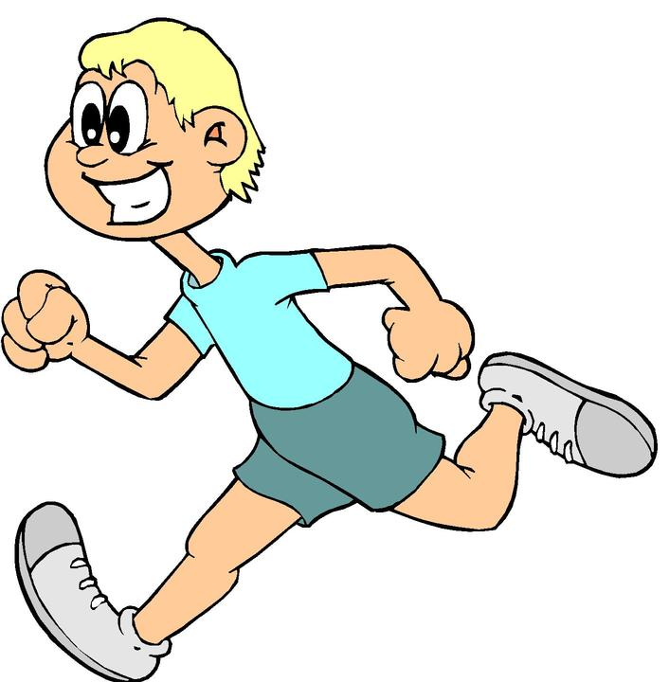
you
run
you
/ue/
/r/
/u/
/n/
you
you
=
=
/ue/
/ue/

Slide 6

you
sing
you
/ue/
/s/
/i/
/ng/
you
=
/ue/

Slide 7
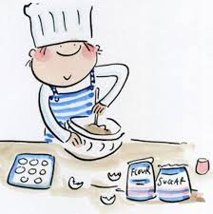
you
cook
you
/ue/
/c/
/oo/
/k/
you
=
/ue/

Slide 8
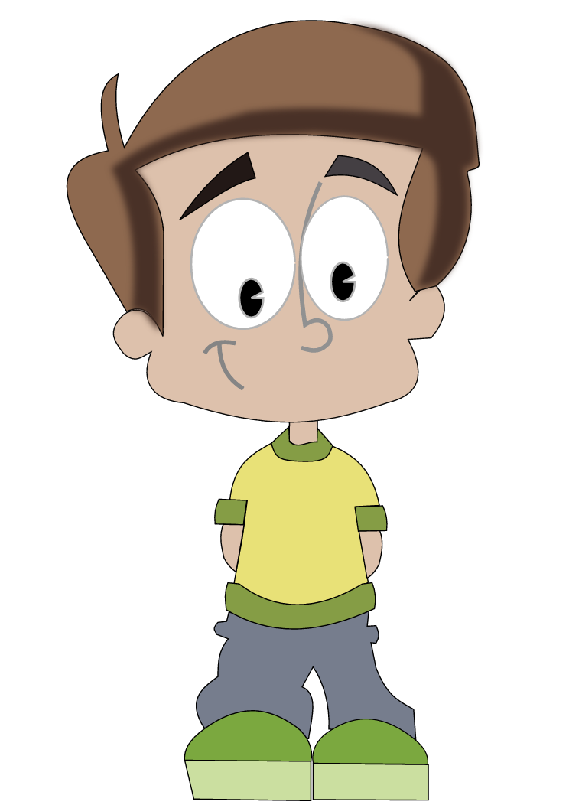
you
you
=
/ue/
you
are
tall
/ue/
/ar/
/t/ all

Slide 9
you
you
=
/ue/
you
are
short
/ue/
/ar/
/sh/ /or/ /t/

Slide 10

you
you
=
/ue/
you
are
fast
/ue/
/ar/
/f/ /a/ /s/ /t/

Slide 11
you
you
=
/ue/
you
are
slow
/ue/
/ar/
/s/ /l/ /oa/

Slide 12

you
you
=
/ue/
you
are
happy
/ue/
/ar/
/h/ /a/ /p/ /ee/

Slide 13

you
you
=
/ue/
you
are
sad
/ue/
/ar/
/s/ /a/ /d/

Slide 14
my
Notes:
Tricky word “my” covered in the Jolly Phonics computer program, JP 2 unit 6. I’ve put it here to make it easier to teach the meaning of your easier.

Slide 15
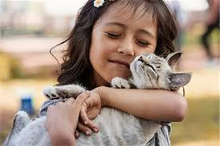
my
=
/m/ /ie/
my

Slide 16

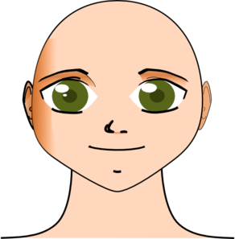
my
hair
my
/m/ /ie/
/h/
/ai/
/r/
my
=
/m//ie/

Slide 17
my
my
=
/m//ie/
my
hair
is
black
/m/ /ie/
/h/ /ai/ /r/
/i/ /z/
/b/ /l/ /a/ /k/

Slide 18

my
my
=
/m//ie/
my
hair
is
brown
/m/ /ie/
/h/ /ai/ /r/
/i/ /z/
/b/ /r/ /ou//n/

Slide 19

my
my
=
/m/ /ie/
my
hair
is
fair
/m/ /ie/
/h/ /ai/ /r/
/i/ /z/
/f/ /ai/ /r/

Slide 20
your
Notes:
Tricky word “your” covered in the Jolly Phonics computer program, JP 2 unit 1

Slide 21
your
=
/ue/ /r/
your

Slide 22
your
=
/ue//r/
your

Slide 23
your
hair
your
/ue/ /r/
/h/
/ai/
/r/
your
=
/ue//r/

Slide 24
your
hair
is
black
/ue/ /r/
/h/ /ai/ /r/
/i/ /z/
/b/ /l/ /a/ /k/

Slide 25
your
hair
is
brown
/ue/ /r/
/h/ /ai/ /r/
/i/ /z/
/b/ /r/ /ou/ /n/

Slide 26
your
hair
is
fair
/ue/ /r/
/h/ /ai/ /r/
/i/ /z/
/f/ /ai/ /r/

Slide 27
come
Notes:
Tricky word “come” covered in the Jolly Phonics computer program, JP 2 unit 2. You might have to bite your lip with this one...

Slide 28
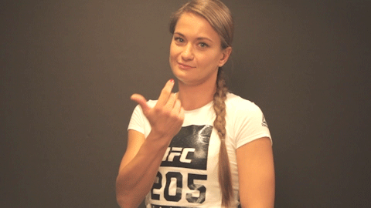
come
=
/k/ /u/ /m/
come

Slide 29

come
here
come
/k/ /u/ /m/
/h/
/ee/
/r/
come
=
/k//u//m/

Slide 30

come
on
come
/k/ /u/ /m/
/o/
/n/
come
=
/k//u//m/

Slide 31
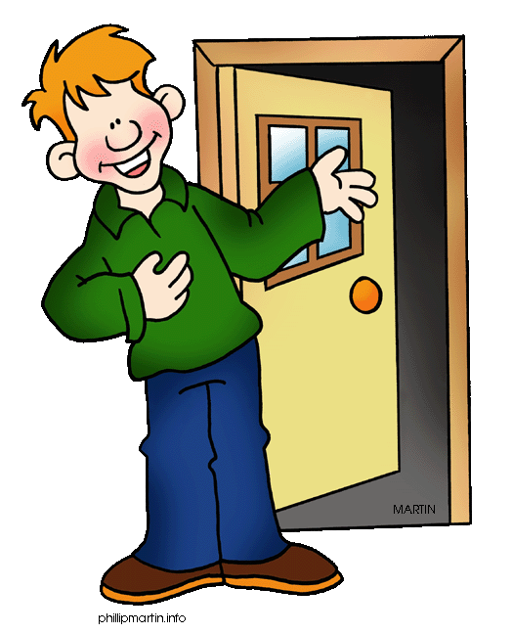
come
in
come
/k/ /u/ /m/
/i/
/n/
come
=
/k//u//m/

Slide 32
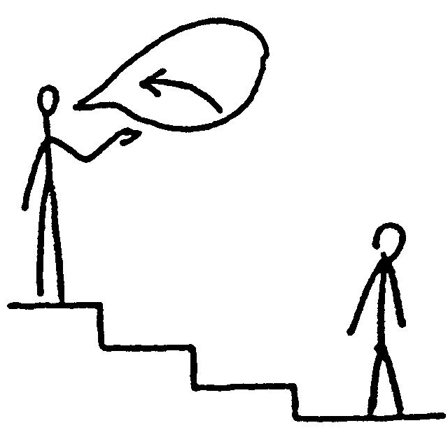
come
up
come
/k/ /u/ /m/
/u/
/p/
come
=
/k//u//m/

Slide 33
some
Notes:
Tricky word “some” covered in the Jolly Phonics computer program, JP 2 unit 2.

Slide 34


some
=
/s/ /u/ /m/
some
How much?
Some!
How many?

Slide 35
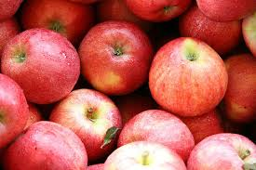
How
many?
some
/h//ou/
/m/ /e/ /n/ /ee/
some
Some
=
/s/ /u/ /m/
/s/ /u/ /m/

Slide 36
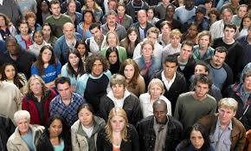
How
many?
some
/h//ou/
/m/ /e/ /n/ /ee/
some
Some
=
/s/ /u/ /m/
/s/ /u/ /m/

Slide 37
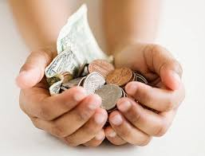
How
much?
some
/h//ou/
/m/ /u/ /ch/
some
Some
=
/s/ /u/ /m/
/s/ /u/ /m/

Slide 38

How
much?
some
/h//ou/
/m/ /u/ /ch/
some
Some
=
/s/ /u/ /m/
/s/ /u/ /m/

Slide 39
said
Notes:
Tricky word “your” covered in the Jolly Phonics computer program, JP 2 unit 3

Slide 40
said
said
=
/s//e//d/
Notes:
Tricky word “said” covered in the Jolly Phonics computer program, JP 2 unit 3

Slide 41

said
now
past
said
“hello”
=
She said “hello”
She says “hello”
/s/ /e/ /d/

Slide 42
said
now
past
said
“bye”
=
She said “bye”
She says “bye”
/s/ /e/ /d/

Slide 43
said
now
past
said
“me!”
=
She said “me!”
She says “me!”
/s/ /e/ /d/

Slide 44
here
Notes:
Tricky word “your” covered in the Jolly Phonics computer program, JP 2 unit 3

Slide 45
here
=
/h//ee//r/
here
Notes:
Tricky word “said” covered in the Jolly Phonics computer program, JP 2 unit 3

Slide 46
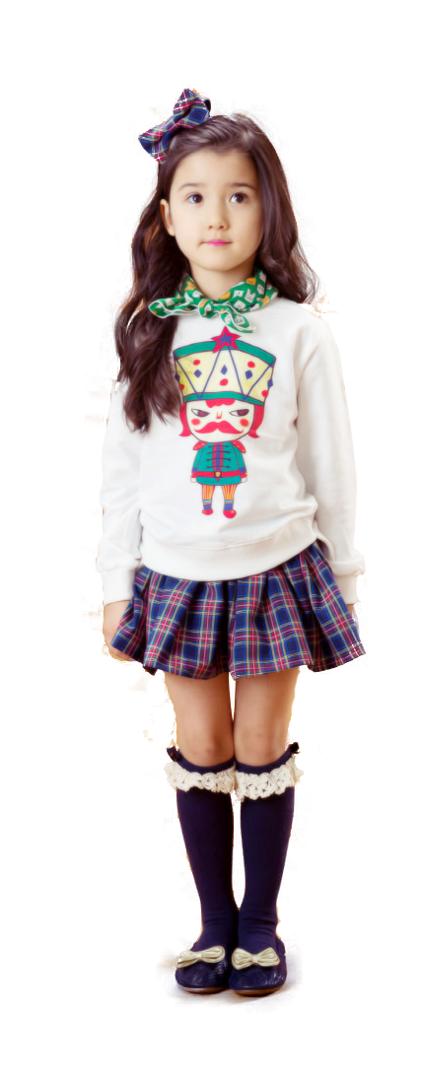
come
here
here
/k/ /u/ /m/
/h/
/ee/
/r/
here
=
/h//ee//r/

Slide 47
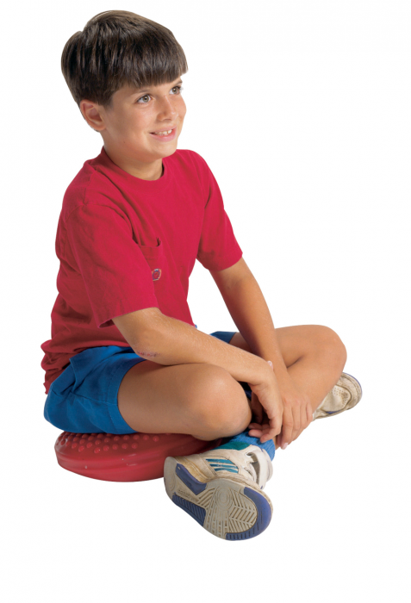
sit
here
here
/s/ /i/ /t/
/h/
/ee/
/r/
here
=
/h//ee//r/

Slide 48


look
here
here
/l/ /oo/ /k/
/h/
/ee/
/r/
here
=
/h//ee//r/

Slide 49
there
Notes:
Tricky word “your” covered in the Jolly Phonics computer program, JP 2 unit 3

Slide 50

there
=
/th//er/
there
Notes:
Tricky word “said” covered in the Jolly Phonics computer program, JP 2 unit 3

Slide 51
go
there
there
/g/ /oa/
/th/
/er/
there
=
/th//er/

Slide 52
sit
there
there
/s/ /i/ /t/
/th/
/er/
there
=
/th//er/

Slide 53
look
there
there
/l/ /oo/ /k/
/th/
/er/
there
=
/th//er/

Slide 54
they
Notes:
Tricky word “they” covered in the Jolly Phonics computer program, JP 2 unit 4

Slide 55

they
=
/th/ /ai/
they
Notes:
Tricky word “said” covered in the Jolly Phonics computer program, JP 2 unit 3

Slide 56

they
run
they
/th/ /ai/
/r/ /u/ /n/
they
you
=
=
/th//ai/
/ue/

Slide 57

they
sing
they
/th/ /ai/
/s/ /i/ /ng/
they
you
=
=
/th//ai/
/ue/

Slide 58
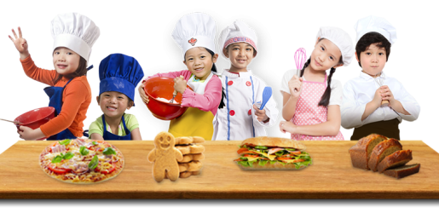
they
cook
they
/th/ /ai/
/c/ /oo/ /k/
they
you
=
=
/th//ai/
/ue/

Slide 59
they
they
=
/th/ /ai/
they
are
tall
/th/ /ai/
/ar/
/t/ all

Slide 60
they
they
=
/th/ /ai/
they
are
short
/th/ /ai/
/ar/
/sh/ /or/ /t/

Slide 61
they
they
=
/th/ /ai/
they
are
fast
/th/ /ai/
/ar/
/f/ /a/ / s/ /t/

Slide 62
they
they
=
/th/ /ai/
they
are
slow
/th/ /ai/
/ar/
/s/ /l/ /oa/

Slide 63
they
they
=
/th/ /ai/
they
are
happy
/th/ /ai/
/ar/
/h/ /a/ /p/ /ee/

Slide 64
they
they
=
/th/ /ai/
they
are
sad
/th/ /ai/
/ar/
/s/ /a/ /d/

